Slide 1

Digital Transformation through
Innovation, Integration, and Convergence
Lukito Edi Nugroho
Departement of Electrical and Information Engineering
Faculty of Engineering, Universitas Gadjah Mada

Slide 2

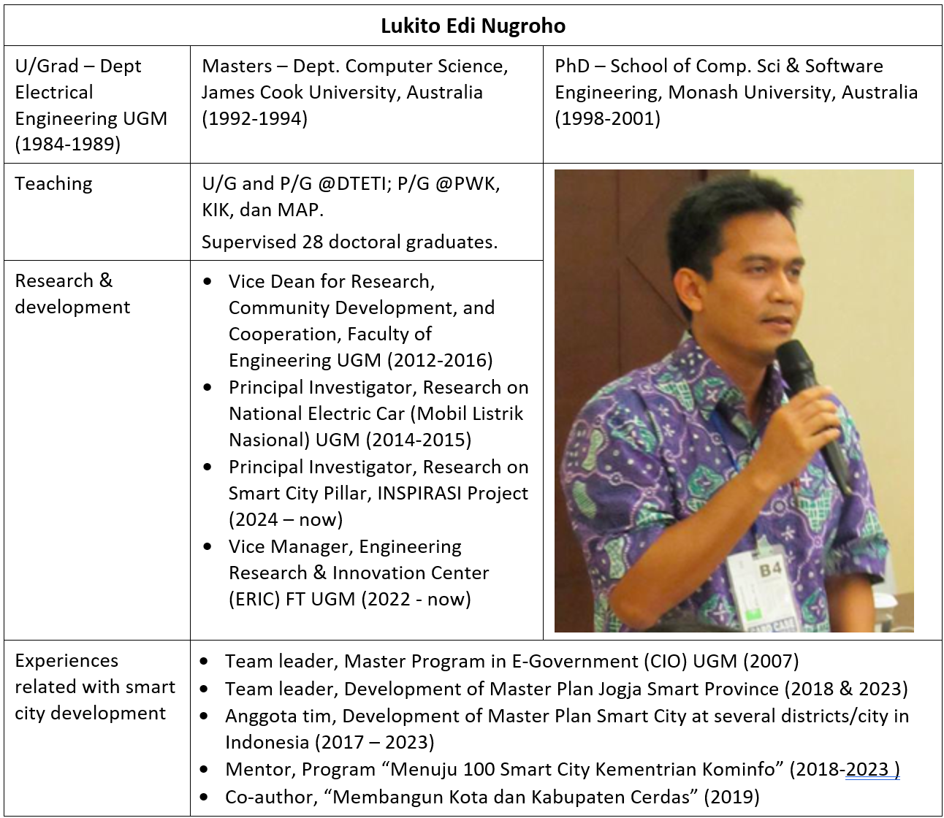

Slide 3
Agenda
What is digital transformation?
Why is it difficult?
Innovation, integration, and convergence
Examples in government/public sectors

Slide 4
What is digital transformation?
Technology deployment
Business agility
Customer-centric innovation
Embedding digital tools into all levels of operations to improve efficiency and customer engagement
Increasing an organization’s ability to quickly adapt to changing market demands and innovations
Focusing on improving customer experience through personalized and seamless digital interactions
McKinsey: the fundamental reimagining of how an organization operates to build a competitive advantage by continuously deploying technology at scale to enhance customer experience and reduce costs
IBM: the strategic adoption of digital technologies to improve processes and productivity, deliver better customer experiences, and drive innovation across industries
Accenture: the process by which companies integrate digital technologies into all areas of their business, fundamentally changing how they operate and deliver value to customers, while also fostering business agility, efficiency, and innovation

Slide 5

Why digital transformation is important (1)
Enhanced Customer Experience: Digital tools allow companies to offer personalized and seamless experiences to customers across multiple channels.
Operational Efficiency: Automation, AI, and data analytics can streamline operations, reduce manual processes, and lower costs. It enables organizations to do more with fewer resources.
Data-Driven Decision Making: Access to real-time data and advanced analytics helps businesses make informed decisions, improving agility and responsiveness to market changes.
Increased Innovation: Digital platforms and technologies facilitate faster development cycles, enabling businesses to innovate and launch new products or services more quickly.

Slide 6

Why digital transformation is important (2)
Competitive Advantage: Companies that embrace digital transformation can stay ahead of competitors by being more agile, responsive to customer needs, and efficient in their operations.
Scalability and Flexibility: Digital solutions allow businesses to scale their operations rapidly and adapt to changes in market conditions without large investments in physical infrastructure.
Better Collaboration and Communication: Cloud-based platforms, digital tools, and remote work capabilities enable improved collaboration and communication, especially in a globally distributed workforce.
Sustainability and Cost Savings: By digitizing processes, companies reduce reliance on physical resources, such as paper and office space, promoting sustainability and reducing costs.

Slide 7
Digital transformation is NOT just about technology
Things often neglected in running digital transformation
Leadership & Change management
Workforce & Talent management
Culture & mindset shift
Process overhaul & Governance
Collaboration & Cross-departmental integration

Slide 8
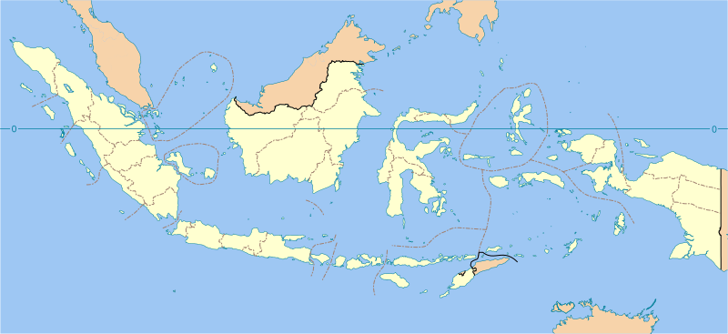
Why is digital transformation difficult?
(especially in developing countries)
Financial constra-ints
Lack of infra-structure
Resist-ance to change
Talent gap
Cybersecurity risks
Regula-tory & policy barriers
Digital divide
Limited access to global resources and markets
vs
Differences in infrastructure, economic growth, purchasing power,
education level, access to information, culture, … and many more
It is just impossible to have one single DT strategy for Indonesia →
each city/region has to devise its own strategy
(different programs, objectives, targets, and levels of ICT support)

Slide 9
Some success stories (1)
Gojek
Success factors | Key actors
Customer-Centric Innovation: Gojek’s transformation revolved around creating a super app that integrated multiple services, from ride-hailing to payments, food delivery, and logistics. | Leadership: The visionary leadership team focused on addressing specific pain points of consumers, driving digital adoption.
Agile Development: The use of agile methodologies allowed Gojek to quickly iterate and scale its digital services across various sectors. | Technology Teams: A highly skilled tech team was crucial in maintaining and scaling the app’s backend services.
Ecosystem Building: Gojek formed strategic partnerships with financial institutions and merchants, creating an extensive ecosystem that leverages digital payments and services.

Slide 10
Some success stories (2)
Telkom Indonesia
Success factors | Key actors
Hybrid Cloud Strategy: Telkom Indonesia leveraged hybrid cloud systems, balancing between in-house infrastructure and cloud solutions, which helped them optimize costs while ensuring data security. | Executive Management: The executive team prioritized digital as a core aspect of their strategy, aligning their operations accordingly.
Digital Workforce: The company invested heavily in upskilling its workforce, ensuring employees were prepared for digital tasks. | Government Support: Telkom Indonesia benefited from governmental initiatives to boost digital infrastructure across the country.
Focus on Digital Products: Through its subsidiary, Telkomsel, the company developed digital products like mobile payment solutions and digital content services, improving customer engagement and revenue streams.

Slide 11
Some success stories (3)
Jakarta Smart City
Success factors | Key actors
Data-Driven Governance: The use of a centralized data platform to collect and analyze real-time information helped optimize public services like waste management, traffic control, and emergency responses. | Local Government Leadership: The Jakarta government played a key role in aligning its urban goals with digital technology, promoting innovation at the city level.
Collaboration with Startups: The government partnered with local tech startups to develop and implement solutions such as the Qlue app, which enables citizens to report problems like potholes or floods directly to authorities. | Technology Providers and Startups: Private sector collaboration contributed significantly to implementing scalable digital solutions.
Citizen Engagement: Jakarta Smart City fosters transparency and direct interaction between the government and its citizens by allowing public access to information and services through mobile apps.

Slide 12


Why are many DT projects unsuccessful?
The scale of the problem >> the capability of the executor
… because we do it by ourself, with our own capability

Slide 13
An example of an unsuccessful program
The case: The government wants to
empower small-scale business through
e-commerce solution (marketplace)
Planning, funding, monev
Office of Small-Scale Industries & Trading
Equipments, software
Product development & marketing
Market
Training, mentoring
With limited resources and capability, the program has little effect & impact

Slide 14
How can it be made better?
Digital transformation programs
Innovation: harnessing
the power of technology
(esp. ICT)
Innovation
Integration & convergence:
consolidating capabilities &
resources from different
stakeholders
Integration & convergence

Slide 15
What is innovation?
A new way of doing something;
It refers to incremental and emergent or radical and revolutionary changes in thinking, products, processes, or organizations;
(Wikipedia)
Characteristics → new
Nature of process → incremental & emergent, or radical & revolutionary
Objects → thinking, products, processes, organizations, ...

Slide 16
Areas of innovation
Product innovation
  A good or service that is new or significantly improved. This includes significant improvements in technical specifications, components and materials, software in the product, user friendliness or other functional characteristics.
Process innovation
  A new or significantly improved production or delivery method. This includes significant changes in techniques, equipment and/or software.
Marketing innovation
  A new marketing method involving significant changes in product design or packaging, product placement, product promotion or pricing.
Vacek J. Innovation Management, 2010

Slide 17
Areas of innovation
Organisational innovation
  A new organisational method in business practices, workplace organisation or external relations
Technological innovations
  Based on specific technology, invention, discovery
Social innovations
  In critical historic periods more important than technological ones (mail, educational systém, social systém, health care, …)
Vacek J. Innovation Management, 2010

Slide 18
Innovative ideas must …
Be original
Have different perspectives and thinking
Address real challenges
Add value to users
  Much better than existing products
  Makes users feel “they cannot live without it”
Be implementable

Slide 19
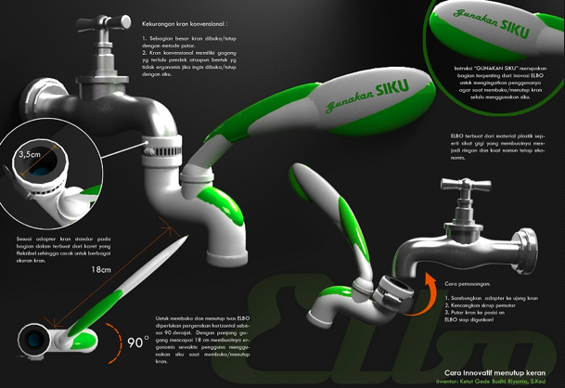
An example
What does this
product do?
http://www.blackxperience.com/bia2012/top20/

Slide 20
ICT for integration
ICT combines several processes and mechanisms along with their supporting resources into a complete unit.
The purpose of integration:
    Building and delivering a new service based on existing ones
    Improving efficiency
    Providing information for decision support

Slide 21

ICT for integration: an example
One-stop service model
Multistakeholders
Different authorities
Different business processes
Data from different sources
A user perceives the
service as a whole

Slide 22
Convergence
The trend of initially unrelated technologies becoming more closely integrated and even merging as they evolve. (Wikipedia)
Convergence forms something new, something bigger, and ultimately builds different views, orders, and ways of working.

Slide 23
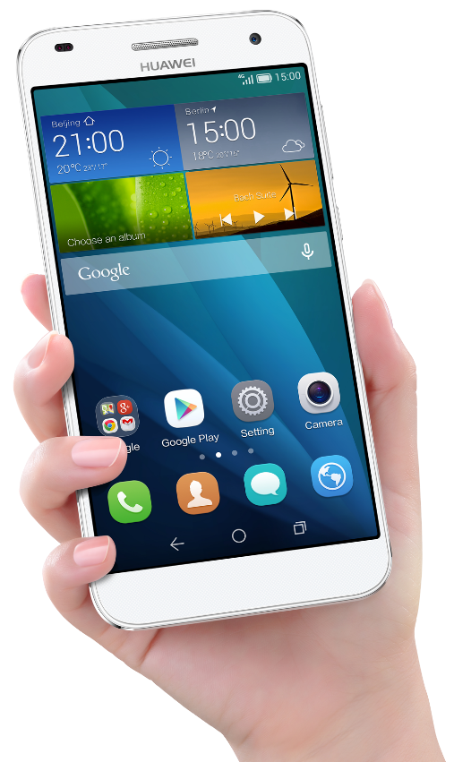
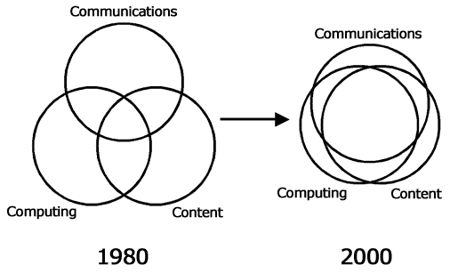
Convergence: A global phenomena
“All in
one hand”

Slide 24
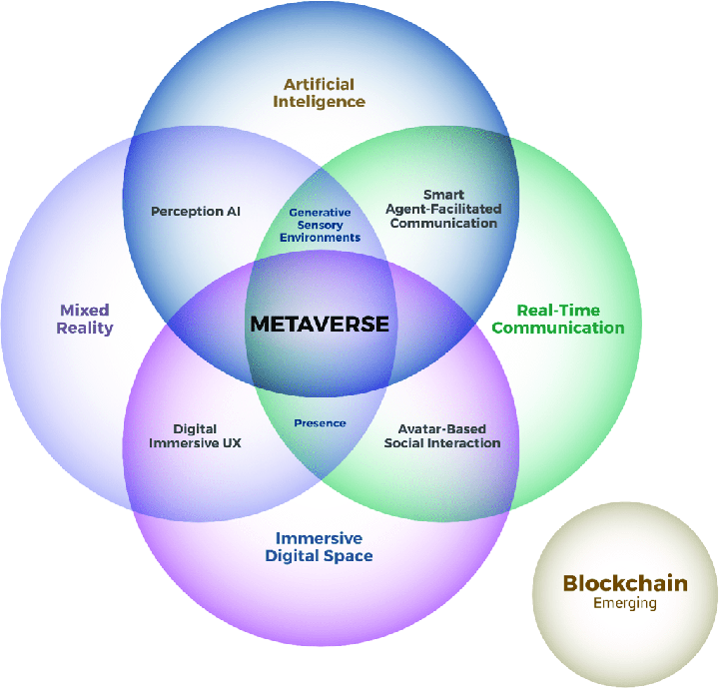
Convergence:
A global phenomena
Technological convergence can
produce new “products” that are
completely different from their
building blocks.
Samala, et.al, 2023, Metaverse Technologies in Education: A Systematic Literature Review
Using PRISMA

Slide 25
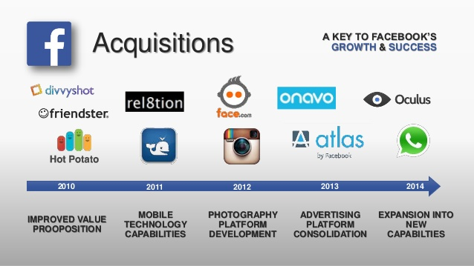
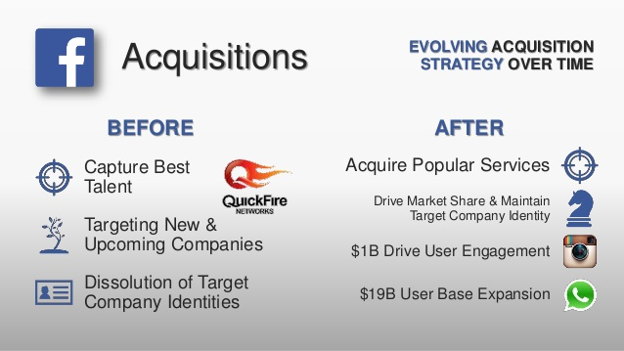
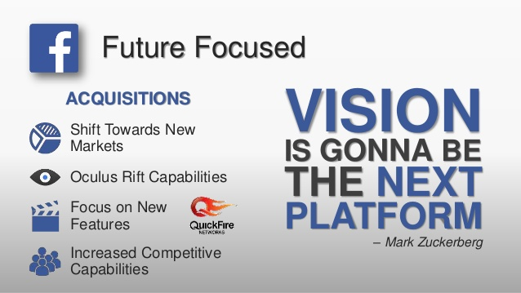
Convergence in business
Facebook bought Whatsapp,
Instagram, Oculus VR, dll:
To build new capabilities

Slide 26
What to innovate in DT?
Research areas (partial list)
Regulation & institutional support:
More responsive regulations for dynamic needs
New/improved organization structure and mechanism
Project & change management:
Agile project management
More effective change management
Tools:
ICT hardware & infrastructure systems
Software & applications
Data engineering
Other tools/equipments (not necessarily ICT)
Literacy:
Adoption of technology
Socioeconomic impact of technology
Institution: Regulation & institutional support
Digital transformation
programs
Innovations for improved performance
The way we work: Change & project management
Technology:
Tools (H/W, S/W, data)
Human resource: Literacy

Slide 27

Integration & convergence in DT
Acceptance & readiness
Connection points
Interconnecting process
Sustaining “glue”
“Seamless
interconnection
among actors”
Shared vision
Digital transformation programs
“All the actions
are converged
towards shared
goals”
Institutionalization: governance, management, resources, collaboration atmosphere

Slide 28
Integration & convergence: circular economy
Actor #1
Actor #2
Actor #3
Actor #4
Actor #5
Household
Garbage/ waste collector
Garbage/ waste “Bank”
Recycler company
Handycraft maker
garbage/waste
revenue
Household
waste
management
Someone does something
for somebody else, and everyone takes benefits
from all the actions
recyclable
garbage/waste
raw materials
sorted recyclable
garbage/waste

Slide 29
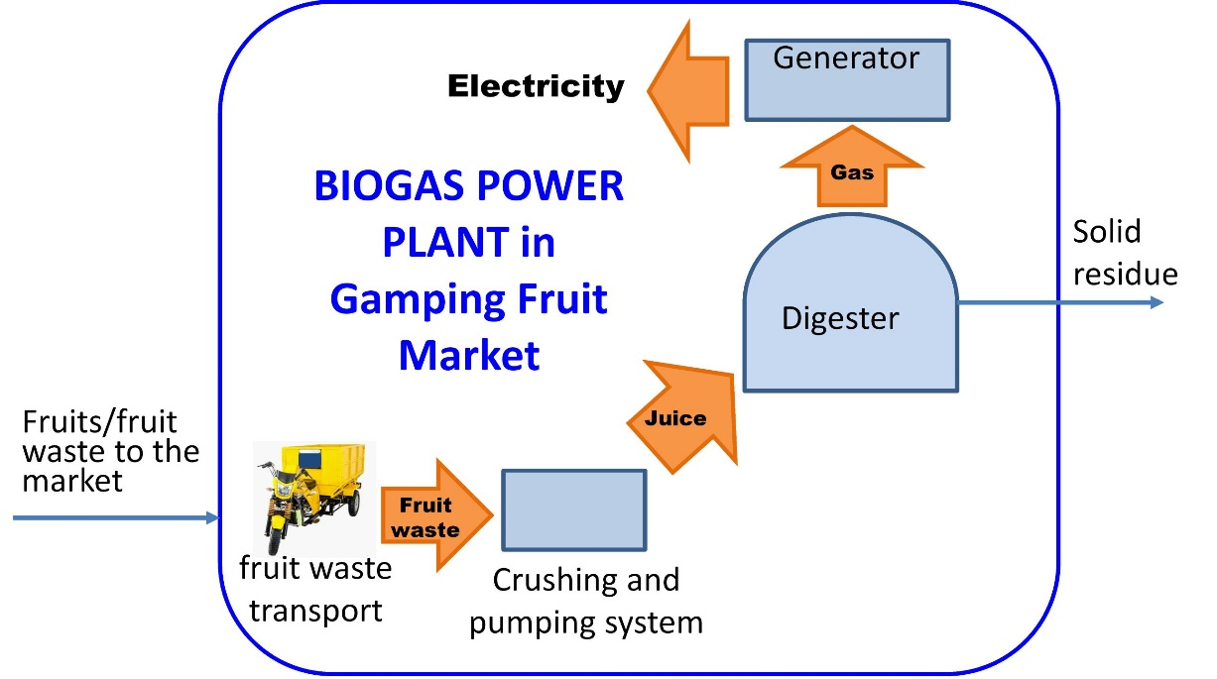
An example of integration and convergence
Sleman District Govt.
UGM & Boras U.
Sweden Govt.
Locus of program
Research
Mentoring
Funding
Technical assistance
Local commu-nity
Biogas power plant in Gamping fruit market
  Execution
  Operational funding
Ariyanto, et.al, (2017), Utilization of Fruit Waste as Biogas Plant Feed and its Superiority Compared to Landfill

Slide 30
A more challenging example
Program: Peningkatan Daya Tarik Destinasi Pariwisata Kegiatan: Pengelolaan Daya Tarik Wisata Sub-k: Pengembangan Daya Tarik Wisata Kabupaten | Rp 100 mil. | Office of Tourism | Tourism Promotion through Social Media and Influencer
Program: Improvement of
Tourist Destination Attraction
Eco-Tourism Based on Local Culture
Tourism
Environment
Program: Pengendalian Pencemaran Dan Kerusakan LH Kegiatan: Pengadaan Sarpras Pengendalian Pencemaran LH
Rp 40 mil.
Office of Environment
“Clean Village Initiative” in tourist destination areas
Innovation at the
Program Level
Culture
Program: Pengembangan Kesenian Tradisional Kegiatan: Pembinaan Kesenian Tradisional Dengan Pelaku Masyarakat Sub-k: Diklat SDM Kesenian Tradisional | Rp 30 mil. | Office of Education and Culture | Training for Tour Guides: Local culture around tourist destinations
Innovation at the
Activity level

Slide 31
Concluding remarks
Mindset.
Sharing. There are elements of an activity that can be shared and used by other parties.
Modularity. Composition. Activities are constructed from their elements, which can be brought by other parties.

Slide 32

THANK YOU
Facebook: lukito.nugroho
Instagram: lukito.nugroho
Youtube: youtube.com/c/LukitoEdiNugroho

